Slide 1
Univariate Analysis: Introduction
Notes:
Hello and welcome to module 2 of the data mining track!
Today we will be exploring the topic of Univariate Analysis!

Slide 2

Module 2 Instructor
Eric Cui
Dual Degree: MD / PSM BMHI
University of North Carolina at Chapel Hill
eric_cui@med.unc.edu
Office hours
Notes:
Before we begin, I would like to introduce myself.
My name is Eric Cui and I will be your instructor for this module.
I am a dual degree student at UNC Chapel Hill. I am pursuing an MD from the UNC school of medicine and have finished my second year.
I am also pursuing a master’s degree in biomedical and health informatics.
If you have any questions for the course, please feel free to email me.
There will also be pre-specified office hours held this summer where you can speak to me via video call if you prefer.
Now lets jump right in!

Slide 3
What is Univariate Analysis?
Univariate analysis
An analysis involving a single variable
Uni = “One”
Bivariate analysis
Analysis involving two variables
Multivariate analysis
Analysis involving many variables
Each can provide different types of information!
Notes:
So….what the heck even is Univariate Analysis?
Well lets break the term down.
Uni- means “one”, while “variate” means variable
Putting it together we can conclude that Univariate Analysis is an analysis of a single variable
Using this approach we can also understand several other terms you will hear throughout future modules and beyond if you continue your data science education
These include bivariate analysis, which is the analysis of two variables and multivariate analysis, which is the analysis of many variables (3 or more)
Each different analysis has its own techniques and provide different kinds of information

Slide 4
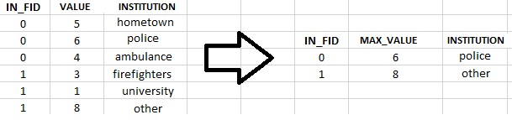
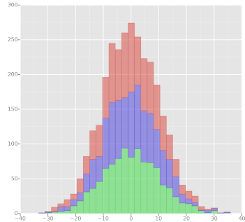
Outline
Univariate Data Visualization
Variable Types
Summary Statistics
Variable
Categorical
Continuous
Notes:
In this module, we will be exploring 3 facet of univariate anlaysis.
First, we will be breaking a variable down by which type of variable it is. This will determine what kind of univariate analysis we conduct for that variable.
Next, we will be exploring summary statistics, which help us get a 10,000 foot view of the data
Finally, we will learn about univariate data visualization which will allow us to quickly ascertain specific information about a variable visually…in other word we will be actually seeing our data and how it can take form!
Throughout this module you will have the chance to both engage with these concept conceptually (through the module videos) and then get a chance to get your hands dirty with each of these concepts through the module notebooks.
Lets keep going.

Slide 5
End of 1st Video for Data Mining Module 2

Slide 6
Univariate Analysis: Variable Types
Notes:
So, first up for module 2 is exploring variable types.

Slide 7
Variable Types
Why?
Variable type determines what can be done to that data
Will alter the type of analysis done
Two Types for this Module
Categorical
Continuous
Notes:
Why is this important?
Well, variable type will tell what we can and can’t do to our data. This will subsequently change the kind of analysis we can do for our variable.
In other words, variable type is critical because it will completely determine the type of univariate analysis we can perform for our variable.
No in terms of variable type, there are two distinct categories, categorical and continuous variables.
There are more detailed and nuanced categories that people have come up with, however that is beyond the scope of this course.
Separating variables into these two categories will serve as a good starting point.

Slide 8
Categorical Variables
Variables that contain a limited group of categories
A person’s biological sex
Male/Female
Cancer Staging
Stage I/II/III/IV
Notes:
So what is a categorical variable?
A categorical variables is simply a variable which contains a limited number of categories. In other words, they have a finite number of categories.
One example is a person’s biological sex, this would likely only be two categories, male or female
Another example would be cancer staging, this would likely only be a limited number of categories again, for instance there may only be four categories, stage 1, stage 2, stage 3, and stage 4
What these two example share in common is they have a limited number of categories

Slide 9
Continuous Variables
These are numeric variables. They can have potentially an infinite number of possible values between two pre-specified values.
Age
Any number between 0 – 125
Weight
Any number between 0 – 600
Note: Upper and lower limits are arbitrary. In this case, limits are based on what is considered to be realistically possible.
Notes:
On the other end are continuous variables
These are essentially numeric variables. Unlike categorical variable, these can take on an unlimited number of possible categories or values. Commonly the range of value they can take on is limited by 2 pre-specified values
One example is age, a dataset may have a person’s age in year, this variable could likely take on any value as long as it’s a realistic age (say between 0 years old and 125 years old)
Another example is weight, a dataset may record a person’s weight as a number (in pounds) anywhere between 0 and 600
Although each has a different range of value, they could potentially take on an infinite number of values

Slide 10
Question 1
In our dataset out primary outcome is whether a patient died or not in the first 24 hours. This outcome is represented in the variable “hospital_death”. Is this variable a continuous or categorical variable?
It is a categorical variable
In our dataset, we have information about how old each patient is. This outcome is represented in the variable “age”. It this variable a continuous or categorical variable?
It is a continuous variable
Notes:
So lets take what we learned and apply it.
In the dataset we will be examining, we want to know whether a patient died in the first 24 hours. This outcome is represent with the variable hospital_death. Is this a continuous or categorical variable.
It is categorical, this is because this variable can only take on two categories, deceased or not deceased
Our data also contains information about a person’s age. Is this a continuous or categorical variable?
- It is a continuous variable, this is because this variable can take on any number (between a realistic range)

Slide 11
End of 2nd Video for Data Mining Module 2

Slide 12
Univariate Analysis: Summary Statistics
Notes:
We will now be exploring summary statistics

Slide 13
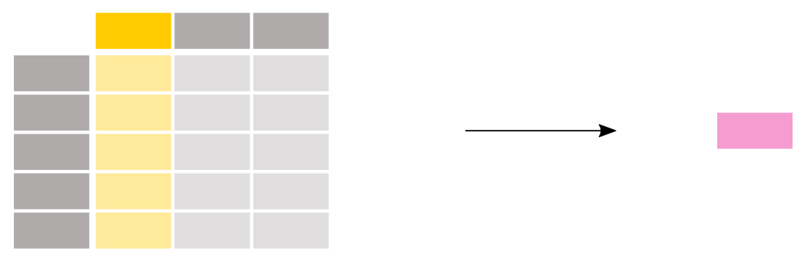
Summary Statistics
Information that generally describes your data. Summary statistics will summarize your observations.
Notes:
What are summary statistics?
Summary statistics is information which succinctly describes your data. In other words, it summarizes your data.
This is extremely useful, commonly in data analysis you may be dealing with thousands or even millions of data points. It’s impossible for a single person to look through each individual point.
Instead what they can do is obtain summary statistics to quickly get an overview about specific characteristics of their data.
Now what kind of summary statistics you calculate will be dependent on your variable type.

Slide 14
Continuous Variable Summary Statistics
Median: the point on a scale that separated a distribution of scores into two groups; one half of the data are above the median and the other half are below the median
Mean: the arithmetic mean; or the sum of the scores divided by the number of scores
Notes:
For continuous variables, there are two main summary statistics we will be covering, median and mean.
The median is the point on a scale that would separate a distribution of values or scores into two groups with one half of the values being greater than the median and one half being below.
What this means is that the median is essentially taking all the values of a variable, and arranging them in a number line in ascending order of their value. The median is then the middle number of value that would separate this group perfectly in half with half of the value being greater than the median and half of the values being lower than the median.
The next summary statistics is the mean. This is essentially the sum of all of the values in a variable divided by the number of values there are.

Slide 15
Continuous Variable Summary Statistics (cont…)
Example: 1, 2, 2, 3, 4, 7, 9
Median
{1, 2, 2, 3, 4, 7, 9}
3
Mean
(1+2+2+3+4+7+9)/7 = 4
Notes:
Sometimes having only the technical definition may make these concepts hard to understand. Lets see and example.
Say you have this set of number you see here. We will be calculating both the median and mean of these numbers.
For the median, we would arrange these numbers in sequential order. We would then figure out if there is a value in the middle of these numbers. In this case, the middle number is 3.
Now we will calculate the mean for these numbers. First we add up all of the numbers together, then we divide by the total amount of numbers there are. In this case, there are 7 numbers. At the end we obtain the mean, which is 4.

Slide 16
Continuous Variable Summary Statistics (cont…)
Outliers!
Data that differs significantly from others observations
Can be extremely high or extremely low
Example: 1, 2, 2, 3, 4, 7, 900
Median: 4.5
Mean: 131.3
Median better for data that is skewed or has many outliers
Notes:
When calculating summary statistics, you need to watch out for data points called outliers. These are data are very different from the other observations. For instance, they can be extremely high or low compared to other data. These outliers can have significant and unintended consequences for calculating summary statistics.
For instance, look at the example data below which has an outlier of 900. If you calculate the median you get 4.5. But if you calculate the mean, you get 131.3! This goes to show that median is a much better calculation for skewed data with many outliers compared to mean.

Slide 17
Categorical Variable Summary Statistics
Frequency
The number of observations
Percent
The percentage of that particular category for a variable
Insert table of the hospital death variable
Notes:
For categorical variables, they have their own summary statistics. After all you can’t calculate the mean or median for whether someone is male or female.
Instead what you could do is find the frequency which is the number of each category. Using the previous example this would be the number of individuals that are male or female.
You could then calculate the percent which is the percentage of each category. In the previous example this would be the percentage of individuals that are male or female.

Slide 18
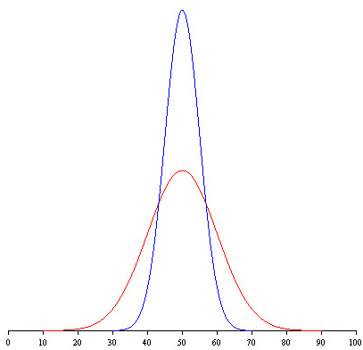
Variability
Notes:
The final aspect of summary statistics we need to talk about is variability. This is how spread out the data is. Above you can see a graph of a blue dataset and a red dataset. Both datasets have the same median and mean. However, you can see that how spread out they are is very different. When calculating summary statistics is important to take into account how spread out the data is.

Slide 19
Variability
Variability show how “spread out” a continuous variable is
Standard deviation: variability measure for means
Interquartile Range (IQR): variability measure for medians
Notes:
So this degree of spread will only apply to continuous variables. Depending on whether you calculate the median or mean there are two measure of variability to be aware of.
The first is standard deviation, this will measure the spread for means.
The second is interquartile range which will measure the spread for medians.
While these are two different measures, the same principle applies, the higher either of these values are, the more spread out the data is.

Slide 20
Question 2
A critical part of any clinical experiment is understanding your patients. Say we have a 10 patient cohort with the following ages in years below.
18, 38, 53, 27, 68, 44, 86, 63, 54, 68
Please calculate the appropriate summary statistics for this cohort
Notes:
So lets take what we’ve learned and apply it.
A critical part of any clinical study is knowing who your patients are and understanding the characteristics of your patient population. Say we have a 10 patient group or cohort with the following ages in years below.
Calculate the appropriate summary statistics for this group.
We can see that our patient group tends to be on the older side. This is important since older patients have different considerations from younger patients. We were able to quickly deduce this information thorough looking at summary statistics. Well done!

Slide 21
End of 3rd Video for Data Mining Module 2

Slide 22
Univariate Analysis: Univariate Data Visualization
Notes:
We will now be exploring univariate data visualization.
NOTE: Need an intro slide explaining this concept.

Slide 23
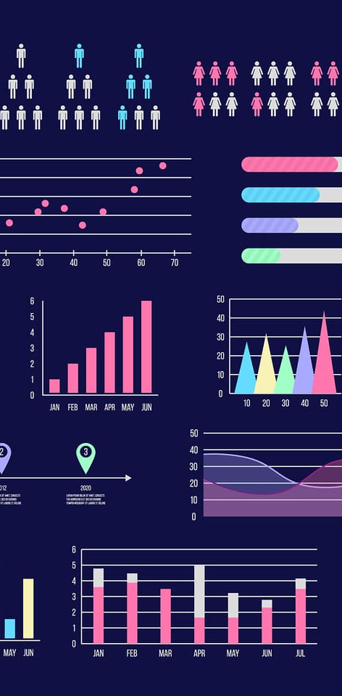
Univariate Data Visualization
Data visualization is the graphical display of information
Quick, easy way to present complex information
Univariate Data Visualization – Data Visualization of One Variable
Notes:
What is data visualization?
Data visualization is the graphical display of information.
Data visualization has many advantages. One of those it allow us to quickly present complex information in a way that is intuitive to understand. People are highly attuned to visual cues and phenomenon. A good data visualization is like the old saying “a picture is worth a thousand words”
As you may have guessed by now, univariate data visualization is data visualization that is concerned with displaying information about a single variable.

Slide 24
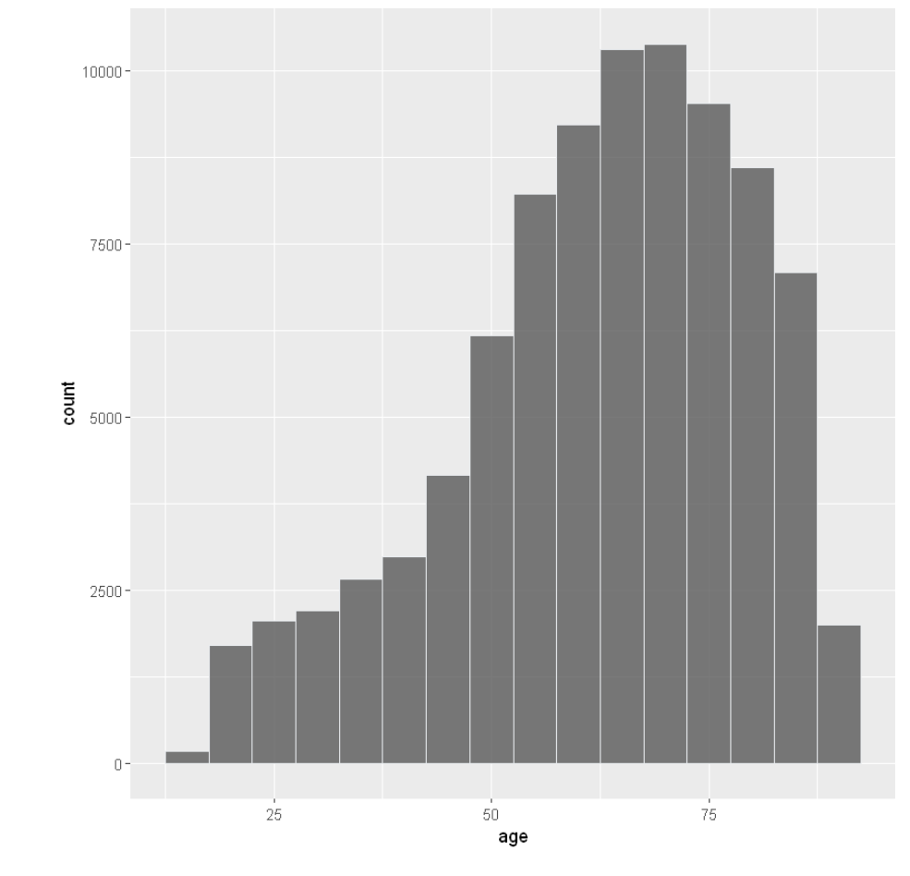
Histogram
Notes:
The first kind of visualization we will be exploring is the histogram. Displayed above is an example of a histogram

Slide 25

Histogram (Cont.)
Data visualization for continuous variables
Graphical display of data using bars of different heights.
Each bar groups numbers into ranges.
Taller bars show that more data falls in that range.
Smaller bars show that less data falls into that range
A histogram displays the shape and spread of continuous data.
Notes:
Histograms are data visualizations for continuous variables. These are graphical displays of data using bars with varying heights. Each bar is a group of numbers that fall into a specific range. Taller bars have more data in that range. Shorter bars have less data in that range. A histogram lets you quickly ascertain he shape and spread of continuous data.

Slide 26
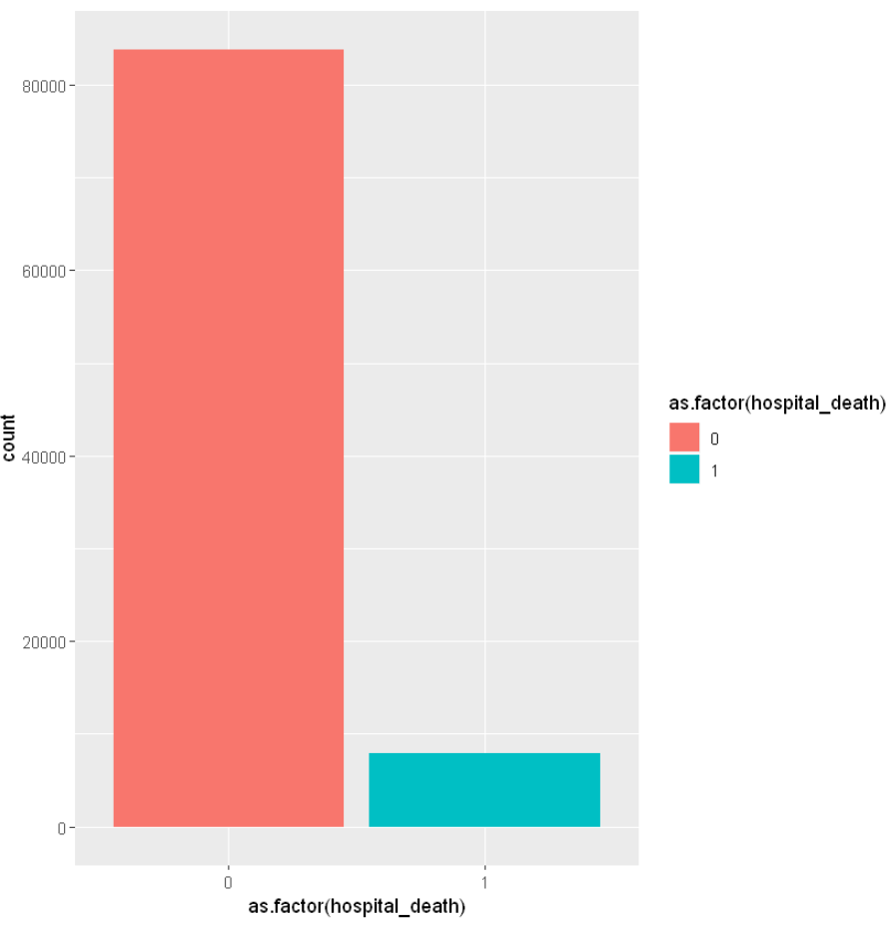
Bar Plot
Notes:
The next plot we will be covering is a bar plot. Above is a depiction of a bar plot, while these may look similar to histograms, they are very different.

Slide 27

Bar Plot (Cont.)
Data visualization for categorical variables
Each bar represents a category
Taller bars show that more data falls in that category
Smaller bars show that less data falls into that category
Notes:
Bar plots are data visualizations for categorical variables.
Each bar represents a category, once again taller bars show more data fall into that category, shorter bars show less data falls into that category.

Slide 28
End of 4th Video for Data Mining Module 2

Slide 29
Univariate Analysis Exercise
For this exercise, you will be performing a univariate analysis for the ethnicity and bmi for our dataset.
Use the appropriate univariate techniques we’ve learned in this module.
Notes:
Finally, we will be engaging in a hand on exercise, this will be a chance for you to take everything you’ve learned in this module and apply it to both a realistic problem and dataset.
You will be performing a univariate analysis for all patient ethnicities and bmi’s for the dataset. Understanding a patient’s demographic and clinic characteristics are important for any clinical study. Be sure to use the appropriate univariate technique for the appropriate variable type.

Slide 30




We are grateful to the following organizations for their support:
Notes:
We would like to take a moment and thank the following organization for their support. These module would not be possible without their support.

Slide 31
Interested in an MPS or a Ph.D. in digital health? Drop us a line: chip@unc.edu.
Notes:
Finally, are you interested further in health analytics or digital medicine? Consider a graduate degree for the University of North Carolina Carolina Health Informatics Program!

Slide 32
End of 5th Video for Data Mining Module 2

